Slide 1
FOREGROUND AND BACKGROUND SEPERATION

Slide 2
Foreground-background separation is a segmentation task, where the goal is to split the image into foreground and background.
In semi-interactive settings, the user marks some pixels as “foreground”, a few others as “background”, and it's up to the algorithm to classify the rest of the pixels

Slide 3
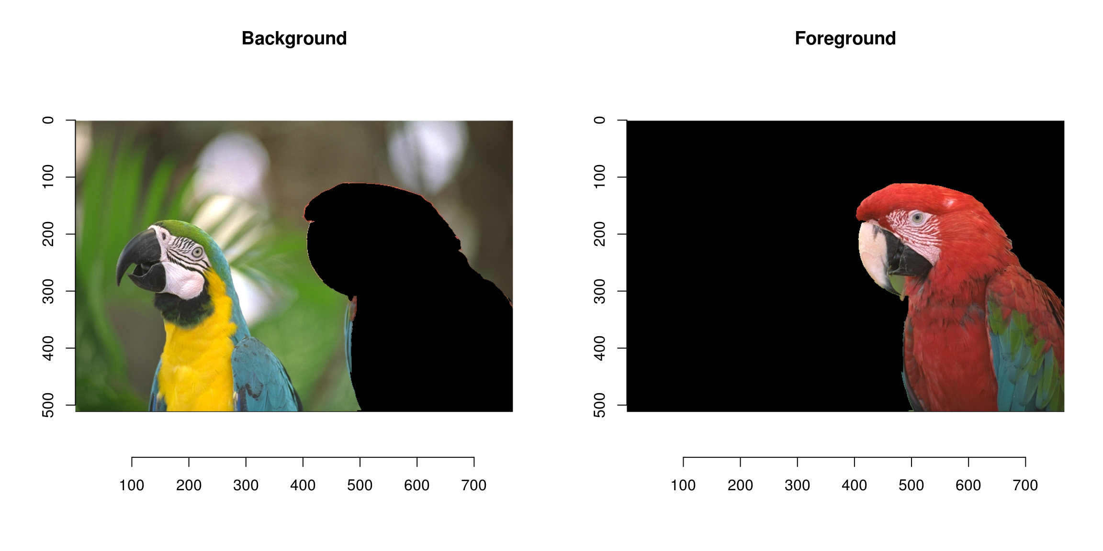

Slide 4
Foreground detection is one of the major tasks in the field of computer vision and image processing whose aim is to detect changes in image sequences.
Background subtraction is any technique which allows an image's foreground to be extracted for further processing (object recognition etc.).
Many applications do not need to know everything about the evolution of movement in a video sequence, but only require the information of changes in the scene, because an image's regions of interest are objects (humans, cars, text etc.) in its foreground.

Slide 5
After the stage of image preprocessing (which may include image denoising, post processing like morphology etc.) object localization is required which may make use of this technique.
Foreground detection separates foreground from background based on these changes taking place in the foreground.
It is a set of techniques that typically analyze video sequences recorded in real time with a stationary camera.

Slide 6
TWO APPROACHES
First, cars moving along a road, or pedestrians in a precinct, are highly variegated, unlike the situation for products appearing on a product line.
Second, there is usually a significant real-time problem, especially when vehicles are moving at up to 100 mph on a highway, and cameras typically deliver 30 frames per second under highly variable conditions. Thus, it pays to capitalizeon the motion of the targets and perform motion-based segmentation.

Slide 7
Background Modeling
To create an idealized background image that can be subtracted from any frame to yield the target or foreground image.
To achieve this, the simplest strategy is to take a frame when there are known to be no targets present and use that as the background model.
In addition, to eliminate noise, it is useful to average a number of frames prior to making observations of targets.

Slide 8
The problems
(a) How to know when there are no targets present, so that frames represent true background?
(b) How to cope with the usual outdoor situation of illumination that varies with the weather and the time of day?

Slide 9
All detection techniques are based on modelling the background of the image, i.e. set the background and detect which changes occur.
Defining the background can be very difficult when it contains shapes, shadows, and moving objects. In defining the background it is assumed that the stationary objects could vary in color and intensity over time.
Scenarios where these techniques apply tend to be very diverse..

Slide 10
There can be highly variable sequences, such as images with very different lighting, interiors, exteriors, quality, and noise.
In addition to processing in real time, systems need to be able to adapt to these changes
A very good foreground detection system should be able to:
Develop a background (estimate) model.
Be robust to lighting changes, repetitive movements (leaves, waves, shadows), and long-term changes.

Slide 11
Background subtraction using a temporal median filter
Background subtraction is a widely used approach for detecting moving objects in videos from static cameras.
The rationale in the approach is that of detecting the moving objects from the difference between the current frame and a reference frame, often called "background image", or "background model". Background subtraction is mostly done if the image in question is a part of a video stream.
Background subtraction provides important cues for numerous applications in computer vision, for example surveillance tracking or human pose estimation.

Slide 12
Background subtraction is generally based on a static background hypothesis which is often not applicable in real environments.
With indoor scenes, reflections or animated images on screens lead to background changes.
Similarly, due to wind, rain or illumination changes brought by weather, static backgrounds methods have difficulties with outdoor scenes.[1]

Slide 13
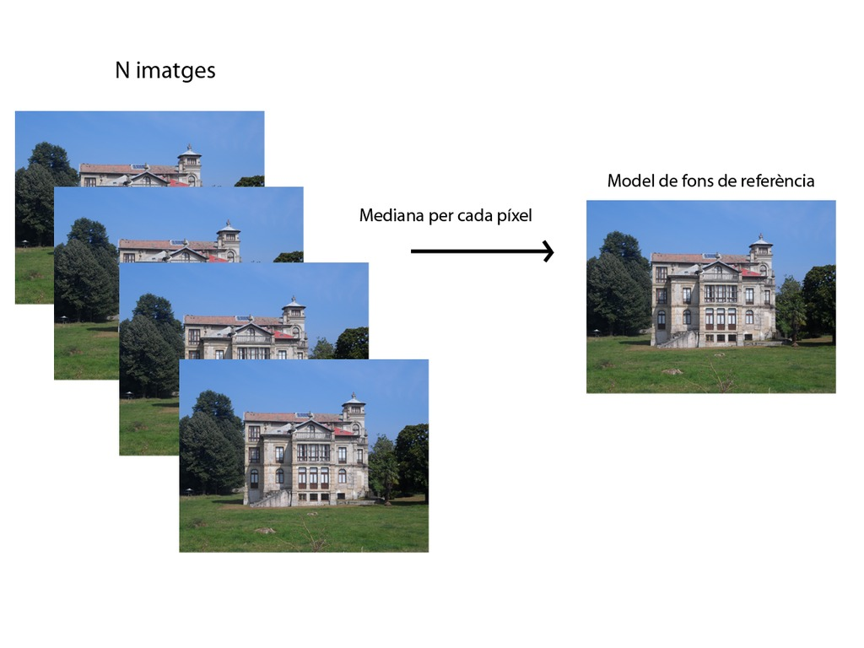
Temporal average filter

Slide 14
Temporal average filter
The temporal average filter is a method that was proposed at the Velastin.
This system estimates the background model from the median of all pixels of a number of previous images.
The system uses a buffer with the pixel values of the last frames to update the median for each image.
To model the background, the system examines all images in a given time period called training time.
At this time we only display images and will find the median, pixel by pixel, of all the plots in the background this time.

Slide 15
After the training period for each new frame, each pixel value is compared with the input value of funds previously calculated.
If the input pixel is within a threshold, the pixel is considered to match the background model and its value is included in the pixbuf.
Otherwise, if the value is outside this threshold pixel is classified as foreground, and not included in the buffer.
This method can not be considered very efficient because they do not present a rigorous statistical basis and requires a buffer that has a high computational cost.

Slide 16
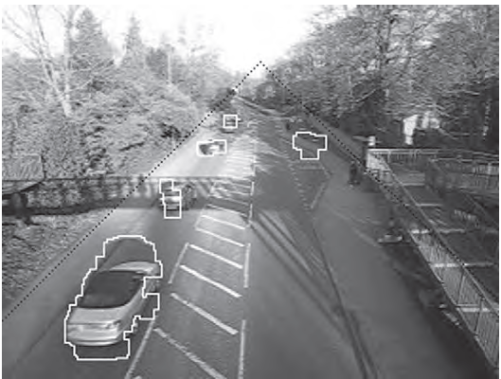
Ghost of the bus appears and then starts to merge back into the background

Slide 17
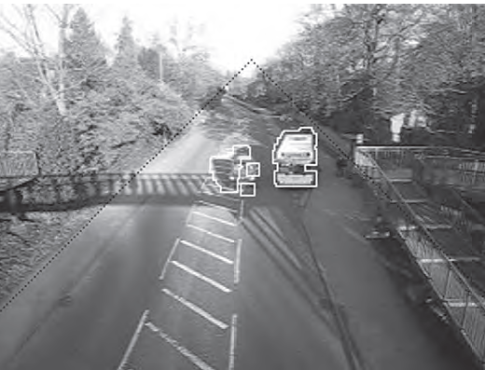
Background subtraction using a restrained temporal median filter

Slide 18
A motion detection algorithm begins with the segmentation part where foreground or moving objects are segmented from the background.
The simplest way to implement this is to take an image as background and take the frames obtained at the time t, denoted by I(t) to compare with the background image denoted by B.
Here using simple arithmetic calculations, we can segment out the objects simply by using image subtraction technique of computer vision meaning for each pixels in I(t), take the pixel value denoted by P[I(t)] and subtract it with the corresponding pixels at the same position on the background image denoted as P[B].
In mathematical equation, it is written as:
{ P[F(t)]=P[I(t)]-P[B]}{P[F(t)]=P[I(t)]-P[B]}
.

Slide 19
The background is assumed to be the frame at time t.
This difference image would only show some intensity for the pixel locations which have changed in the two frames.
Though we have seemingly removed the background, this approach will only work for cases where all foreground pixels are moving and all background pixels are static.
A threshold "Threshold" is put on this difference image to improve the subtraction (see Image thresholding).

Slide 20
{|P[F(t)]-P[F(t+1)]|{Threshold} }{|P[F(t)]-P[F(t+1)]|{Threshold} }
This means that the difference image's pixels' intensities are 'thresholded' or filtered on the basis of value of Threshold.
The accuracy of this approach is dependent on speed of movement in the scene. Faster movements may require higher thresholds

Slide 21
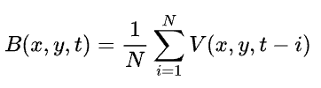
Mean filter
For calculating the image containing only the background, a series of preceding images are averaged. For calculating the background image at the instant t,
where N is the number of preceding images taken for averaging. This averaging refers to averaging corresponding pixels in the given images.

Slide 22

N would depend on the video speed (number of images per second in the video) and the amount of movement in the video.
After calculating the background B(x,y,t) we can then subtract it from the image V(x,y,t) at time t = t and threshold it.
Thus the foreground is

Slide 23
where Th is threshold. Similarly we can also use median instead of mean in the above calculation of B(x,y,t).
Usage of global and time-independent thresholds (same Th value for all pixels in the image) may limit the accuracy of the above two approaches.

Slide 24
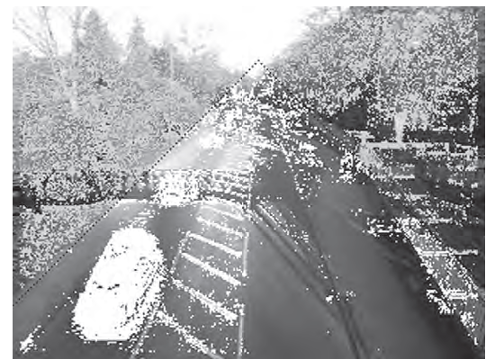
Problems arising immediately after background subtraction

Slide 25
failures arise in two categories
(1) the stationary background problem, in which the shape of the foreground object is not defined accurately enough
(2) the transient background problem, in which the start and stop of the foreground
object aren’t found quickly enough. If the accuracy or reactivity of the background model are inadequate, background subtraction will lead to the detection of false objects: these are called “ghosts”
as indicated above, shadows tend to compound these problems.

